Slide 1
CAMPUS WEAR - GROUP 4
Aim:
The base idea of our project is “Hype and Vice” which is a shopping website for university students with access to multiple university merchandise.
Design Problems:
We want to understand how users would make decisions about what merchandise they would like to buy and how their decision is influenced by different circumstances.
We will then identify the constraints and barriers they face when choosing the items to buy, the selection of university merchandise and their preferences.
https://www.hypeandvice.com/

Slide 2
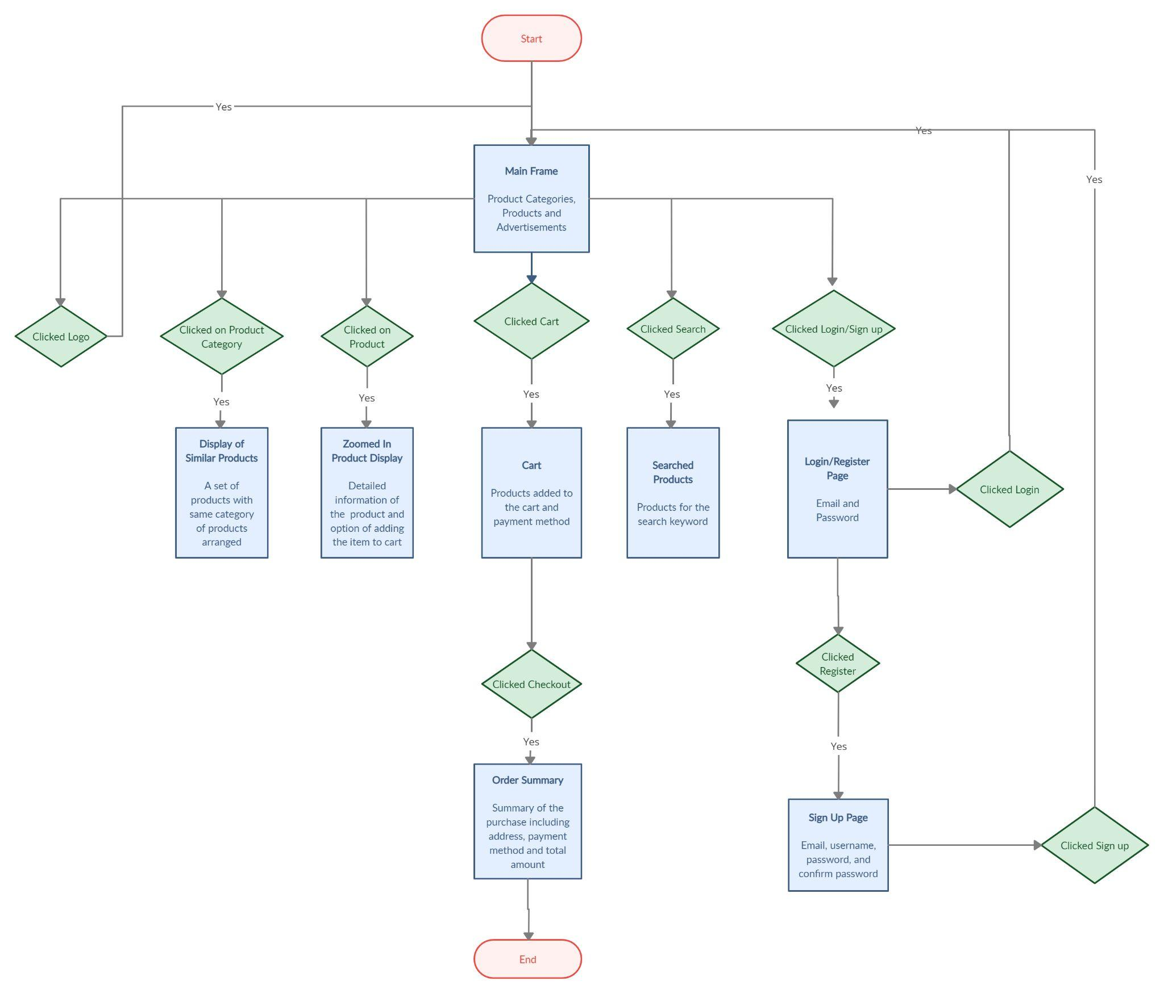
Task Flow Diagram

Slide 3
Wireframes
Link : https://drive.google.com/drive/folders/10xojnhe6OxHAxrpUfjNoOLI-RAVgIKU9?usp=sharing

Slide 4
Interactive Pixel Perfect Prototype
Link:
https://invis.io/AD12KR3RGJWX

Slide 5
Key Integration Principles
Affordance ( Visual Cues ) → CART ICON ( Icon resembles the Physical Shape of Cart )
Feedback ( Visible Response ) → After completing the payment, the user must be redirected to the Order summary page
Consistency → ( Constant Functionalities ) → The Steps to be performed to purchase is product is similar for every item in the website ( CLICK ON ITEM → ADD TO CART → MAKE PURCHASE)
Mapping → ( Relation between controllers and objects ) → The products are correctly mapped with the corresponding price and ratings and all the products are clearly distinguishable.
Constraints ( Restrict Activity of Element ) → The users are not allowed to add a product to cart without selecting the appropriate size of the product.

